Slide 1

Industrial Machine Learning on Hadoop and Spark
Maks Nakhodnov, Bremen 2025

Slide 2
Distributed computing. Algorithms
Plan:
How to process big data? MR Algorithms:
Distinct values, Cross-Correlation
Relational functions
TF-IDF
Graph Processing

Slide 3
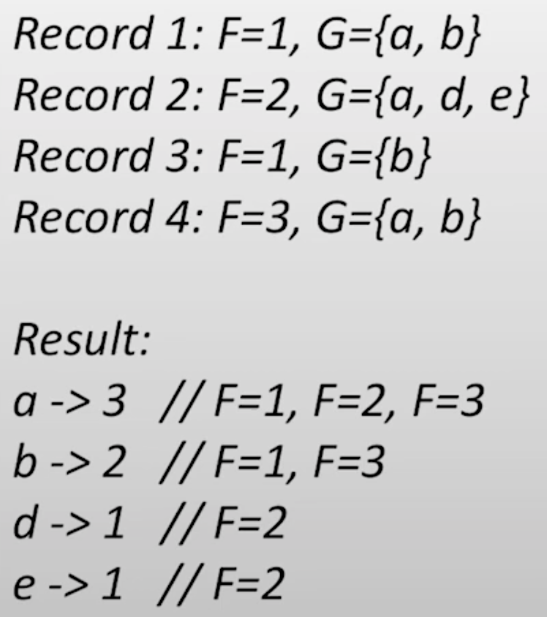
MapReduce. Distinct Values
Count the number of unique values for each group.
Note: #values >> #groups
i.e., user-site interaction —>
values == users, groups == pages

Slide 4
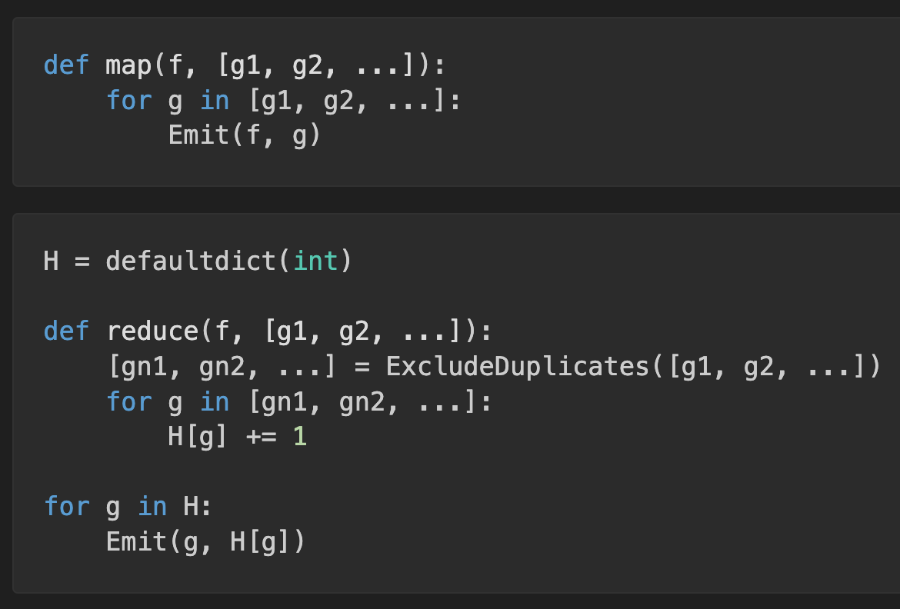
MapReduce. Distinct Values I
The single-phase solution:
Use an associative array to store unique values
Need to use a single reducer or perform post-aggregation (feasible as the number of categories is small)
Requires storing and sorting all groups in memory — may be infeasible

Slide 5
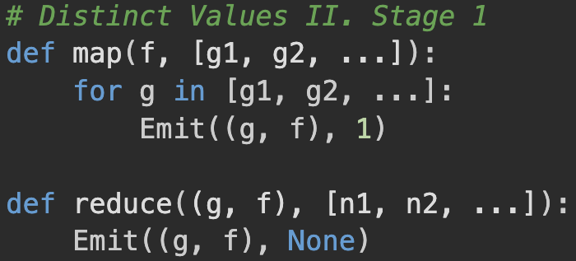
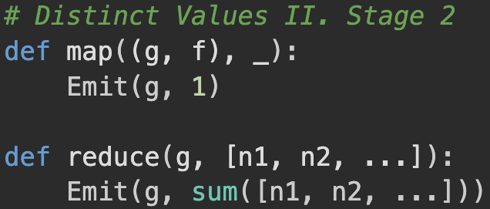
MapReduce. Distinct Values II
The two-phase solution:
Get unique (G, F) pairs
Count the number of F for each G
More complex to implement but more effective

Slide 6
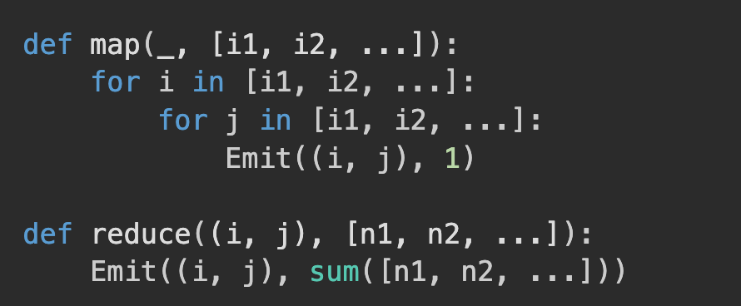
MapReduce. Cross-Correlation I
Count the cooccurrences for every pair in the set of tuples:
Simple, but network-heavy solution ($O\left(n^{2}\right)$ pairs to sort):

Slide 7
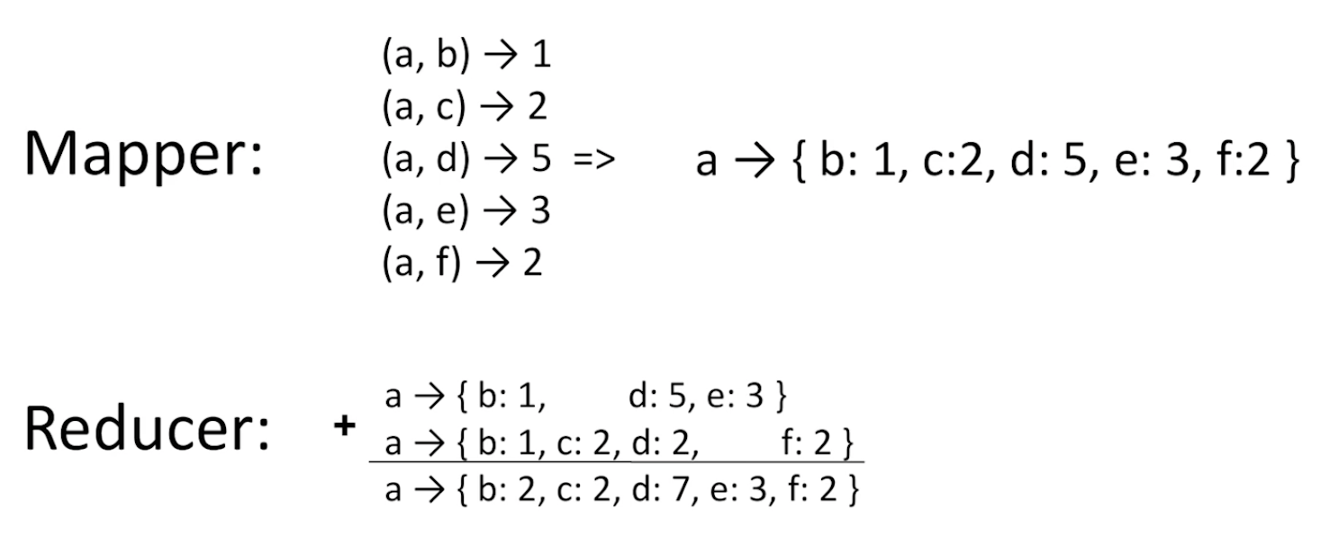
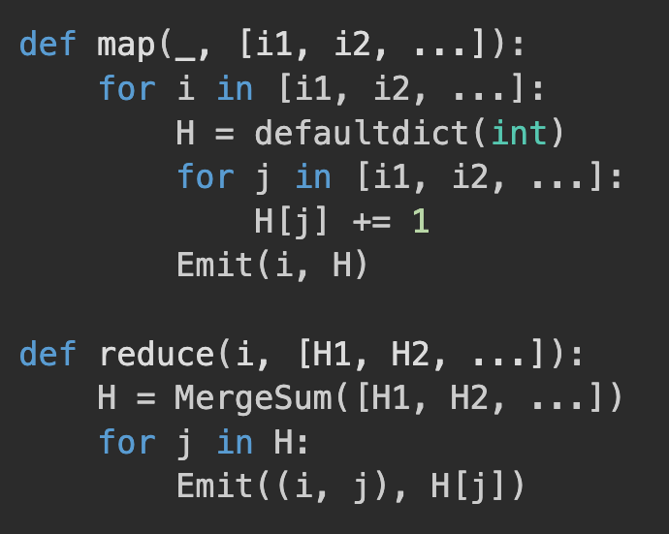
MapReduce. Cross-Correlation II
Count the cooccurrences for every pair in the set of tuples:
Advantages:
Sort & shuffle performed more effectively
Can be used with Combiner
Disadvantages:
More complex implementation
Need to manage Mapper/Reducer RAM
More complex objects to be sent

Slide 8
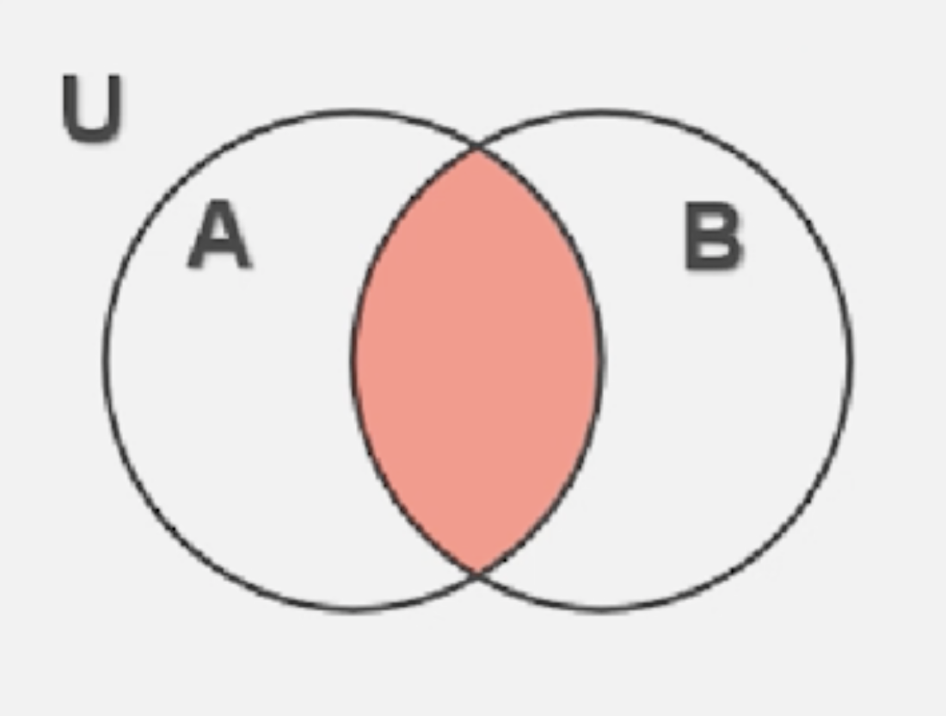
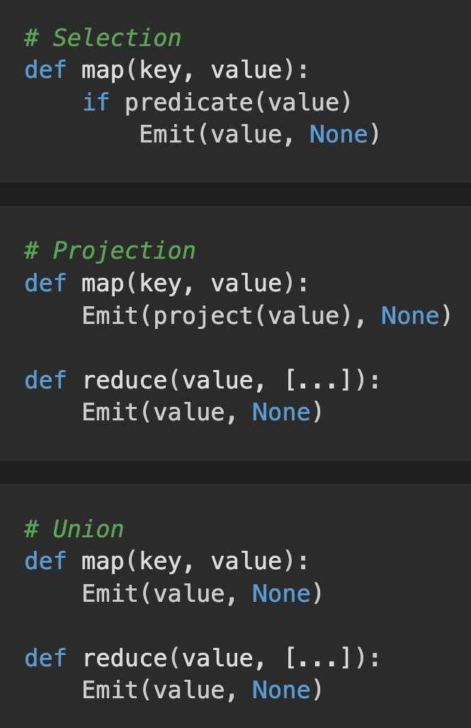
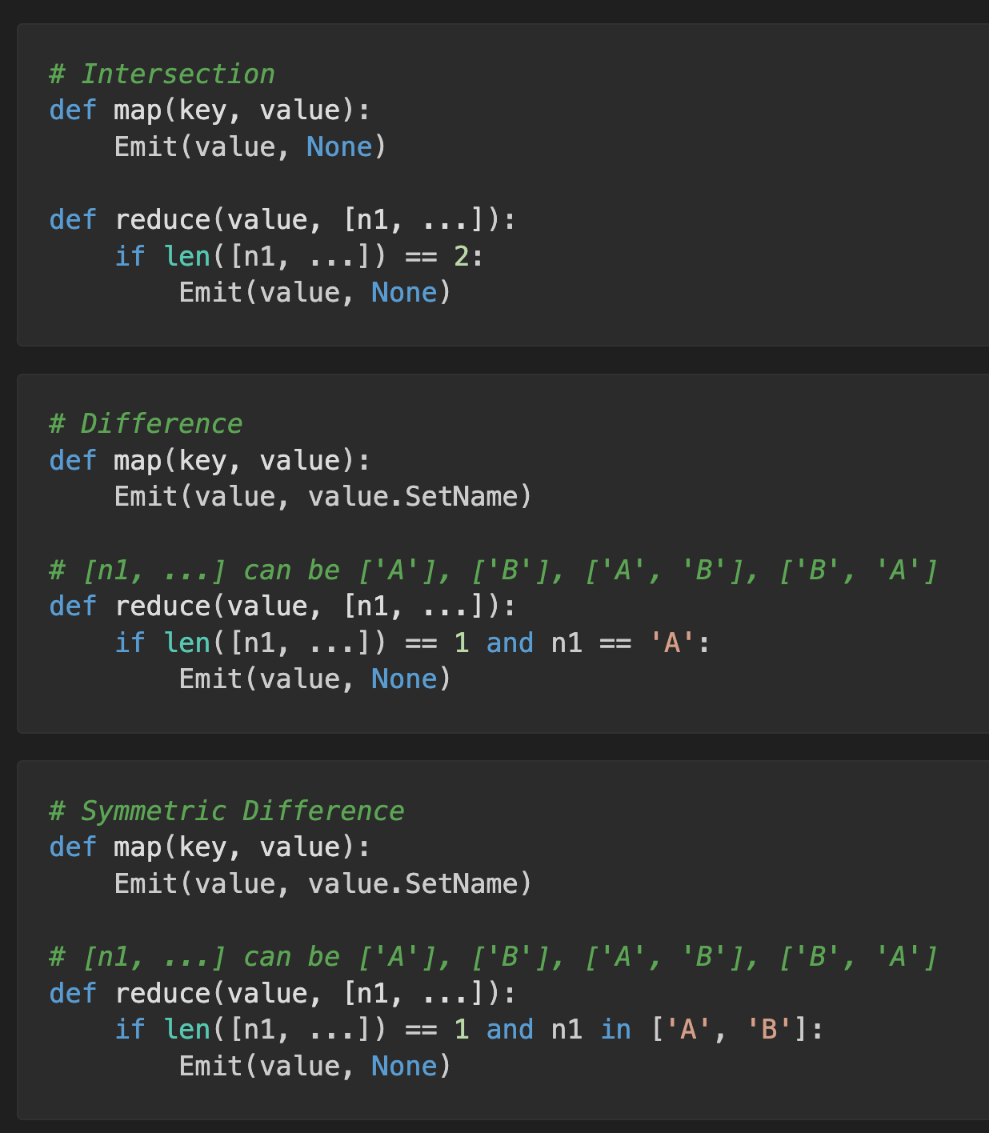
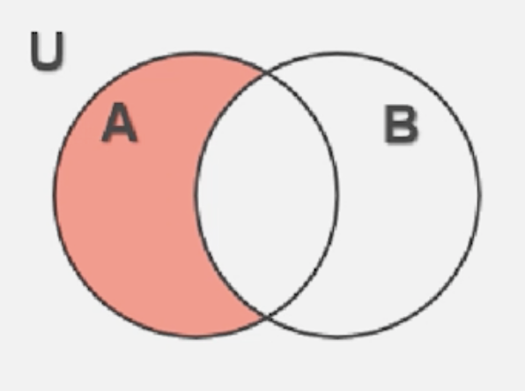
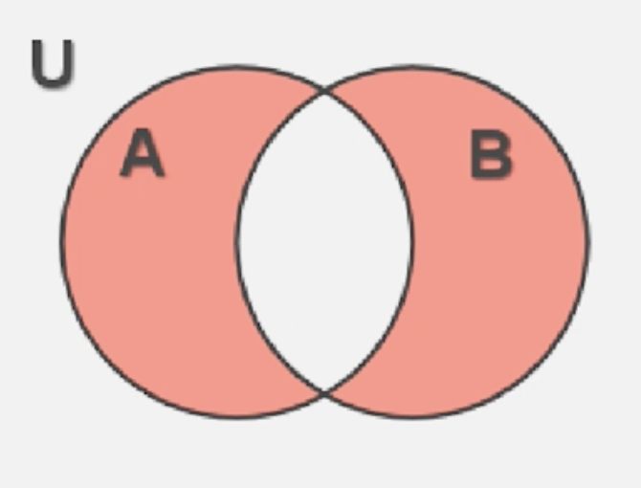
MapReduce. Relational Functions. Sets

Slide 9
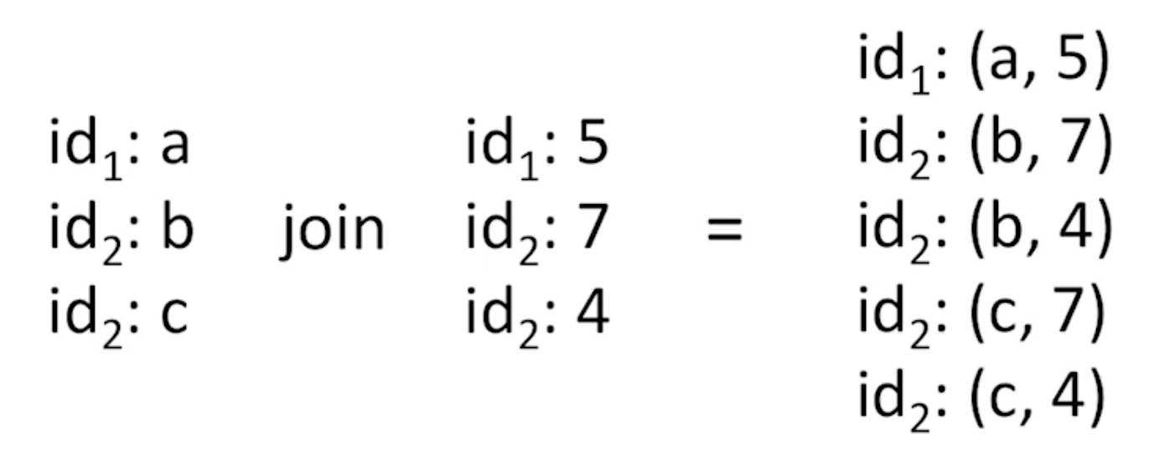
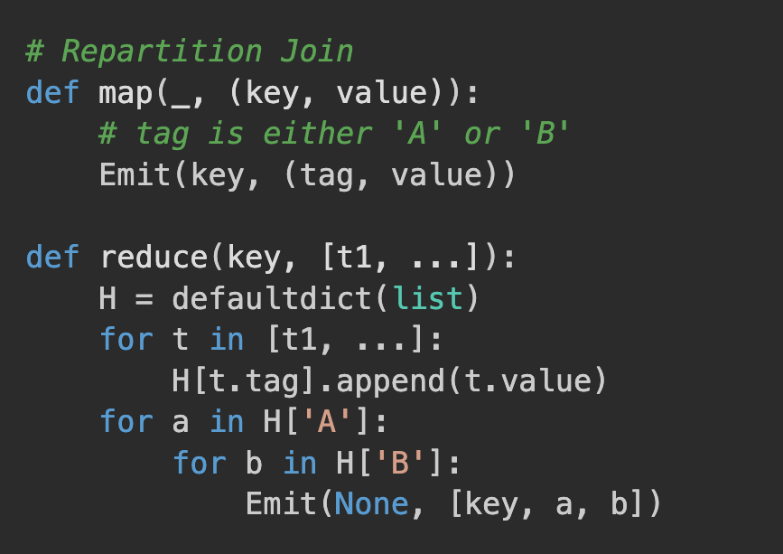
MapReduce. Repartition Join I
Need to manage Reducer RAM
For each key, we have to store all corresponding values
Will fail if one of the sets is large

Slide 10
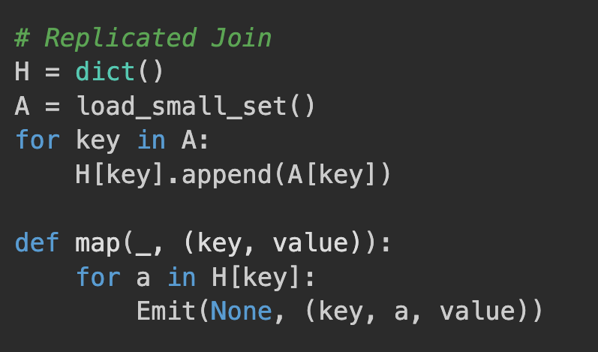
MapReduce. Repartition Join II
Load the small set in each mapper
Use in-mapper combiner
If one of the sets is small, we can use a broadcast join

Slide 11
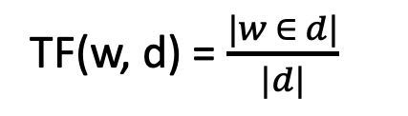
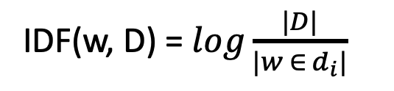
MapReduce. TF-IDF
TF-IDF: Term Frequency — Inverse Document Frequency
Still useful for Information Retrieval tasks
Simplest text vectorization
For each pair (word, document), give its importance
IDF penalizes the frequent words
TF encourages words that appear frequently in the document
TF(w, d) = $\frac{|w ∈ d|}{|d|}$
IDF(w, D) = $log\frac{|D|}{|w ∈ d_{i}|}$
TF-IDF(w, d) = TF(w, d) x IDF(w, D)

Slide 12
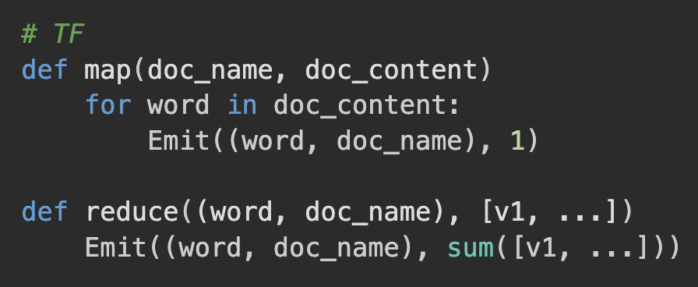
MapReduce. TF-IDF. Stage I. TF
Mapper:
— Input: (doc_name, doc_content)
— Output: ((word, doc_name), 1)
Reducer:
— Sums the values from the mapper
— Outputs: ((word, doc_name), tf)
Combiner: same as the Reducer

Slide 13
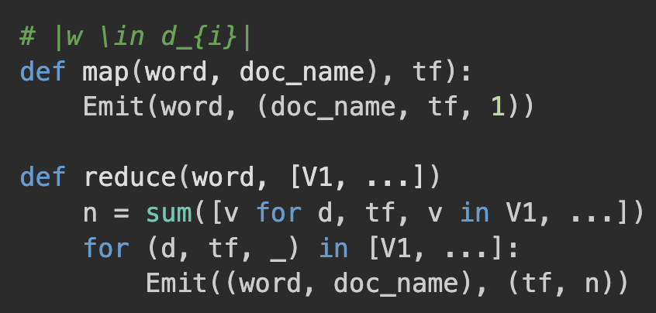
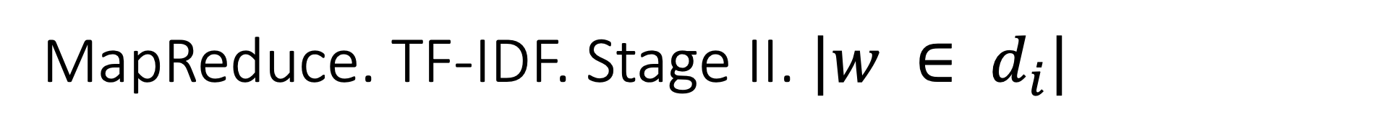
MapReduce. TF-IDF. Stage II. $|w ∈ d_{i}|$
Mapper:
— Input: ((word, doc_name), tf)
— Output: (word, (doc_name, tf, 1))
Reducer:
— Sums ones from the mapper
— Output: ((word, doc_name), (tf, n))

Slide 14
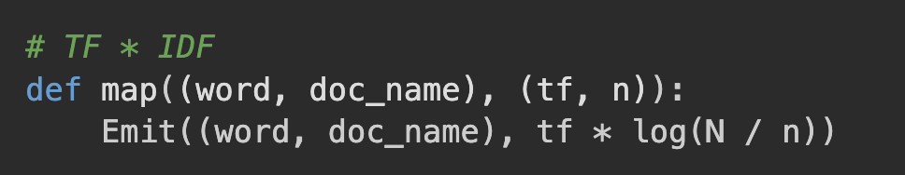
MapReduce. TF-IDF. Stage III

Slide 15
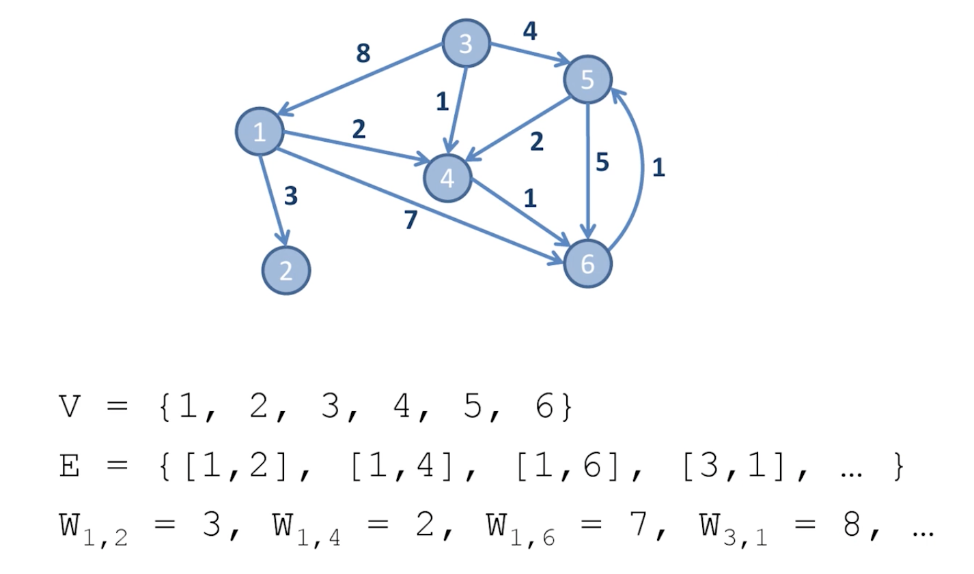
MapReduce. Graph processing
G = (V, E)
V is a set of vertices (nodes)
E is a set of edges (links)
Each edge or vertex can contain additional information
Examples of large graphs:
Social graph
Network graph
Road graph
…

Slide 16
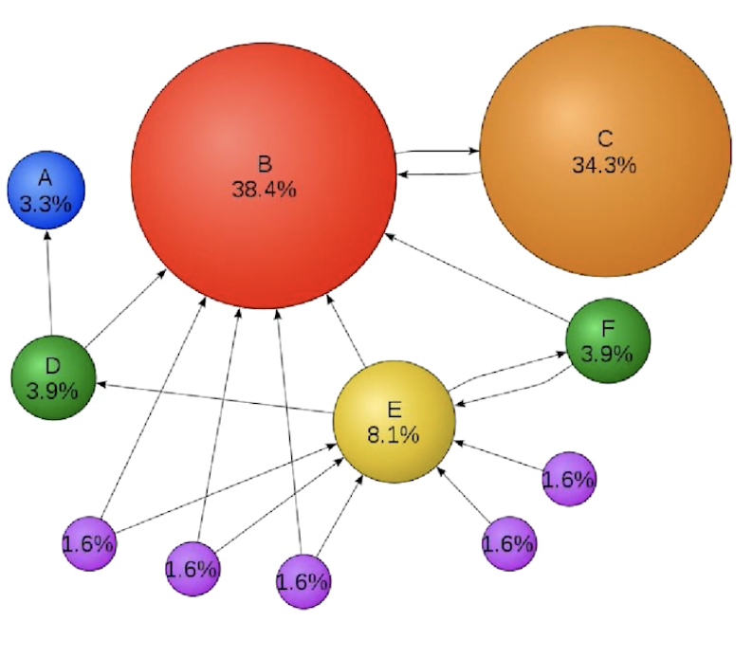
MapReduce. Graph processing
The common algorithms:
Graph traversal
The shortest path (between two nodes or between all nodes)
Minimum Spanning Tree
Max Flow
Property evaluation
Web pages ranking
PageRank
HITS

Slide 17
MapReduce. Graph processing
Key questions:
How to store a graph in MapReduce?
Have to partition a graph somehow
How to traverse a graph in MapReduce?
Have to process each chunk independently and then merge them back

Slide 18
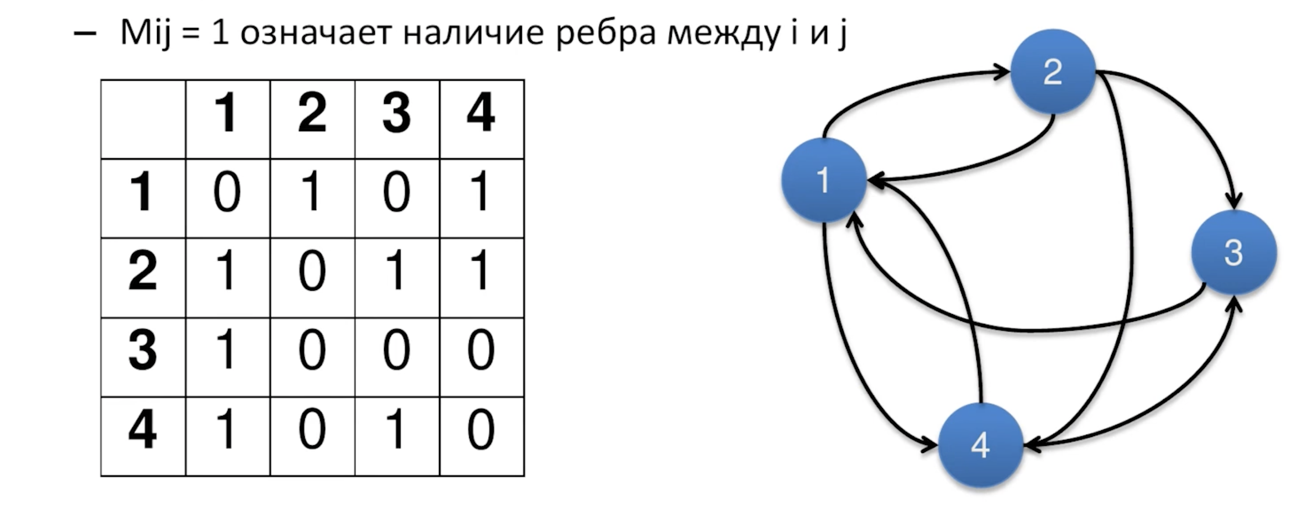
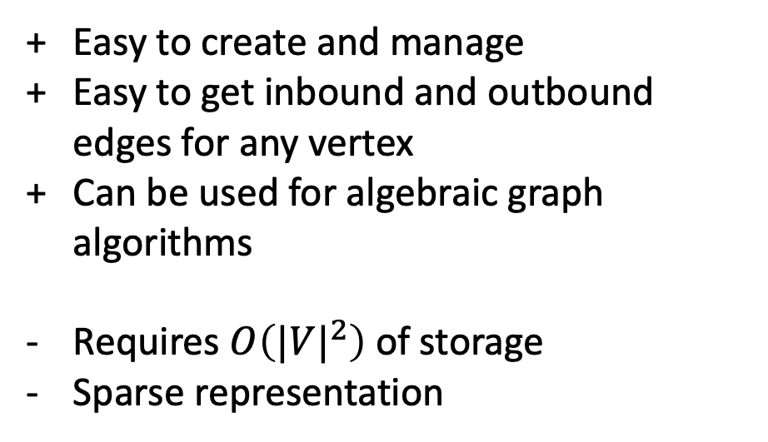
MapReduce. Adjacency matrix
Easy to create and manage
Easy to get inbound and outbound edges for any vertex
Can be used for algebraic graph algorithms
Requires $O\left({|V|}^{2}\right)$ of storage
Sparse representation

Slide 19
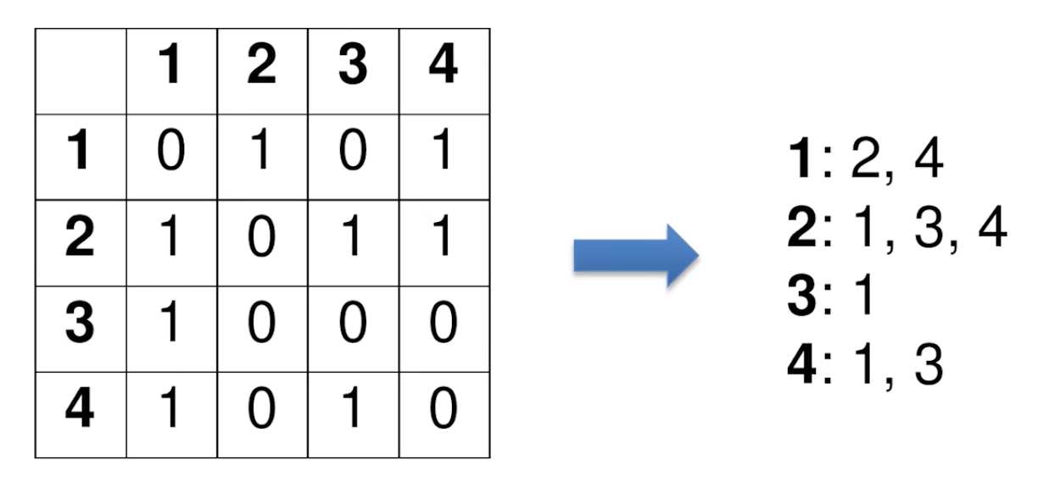
MapReduce. Adjacency list
An effective way to store a graph
Easy to get outbound edges for any vertex
Hard to get inbound edges for any vertex

Slide 20
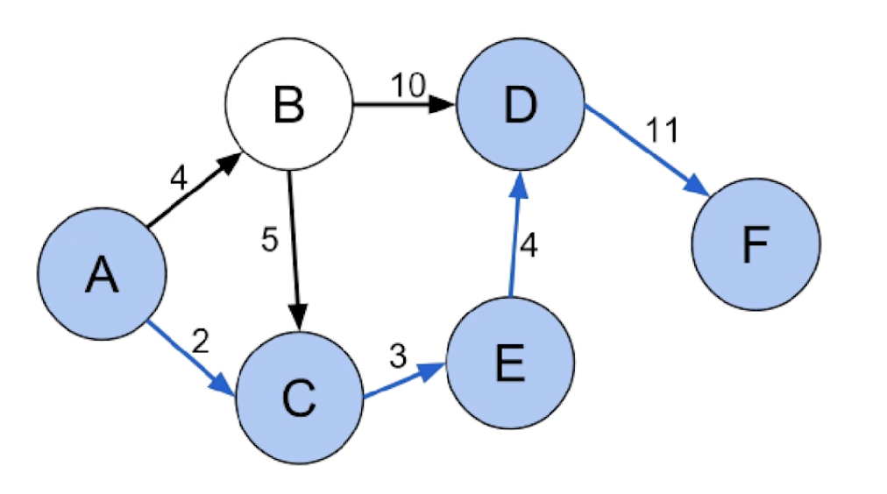
MapReduce. The shortest path
Find the shortest path between two nodes.
Assume all edges have non-negative cost.

Slide 21
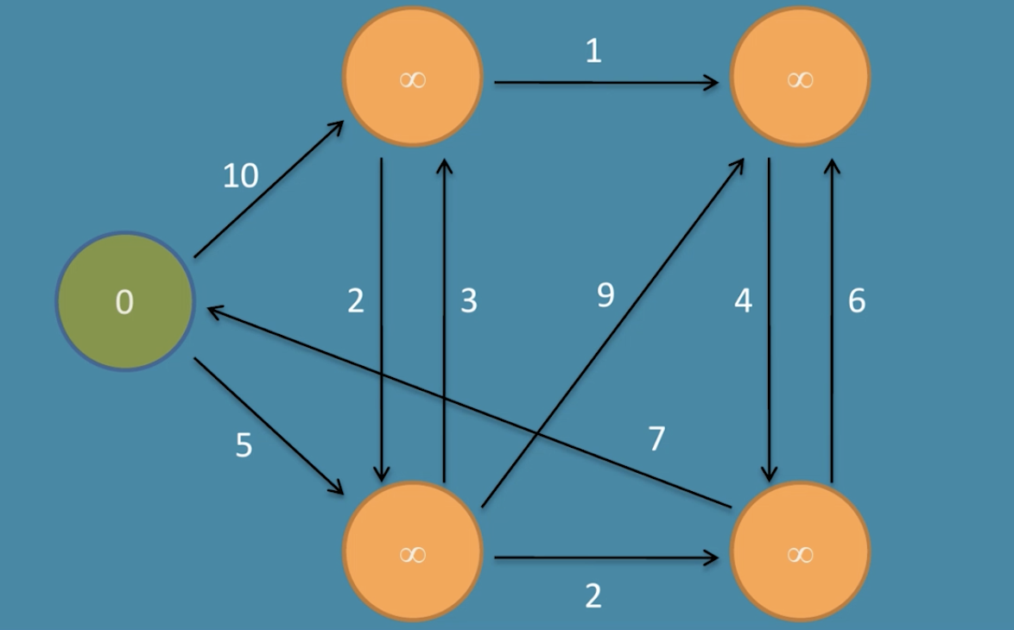
MapReduce. Dijkstra's algorithm. Example

Slide 22
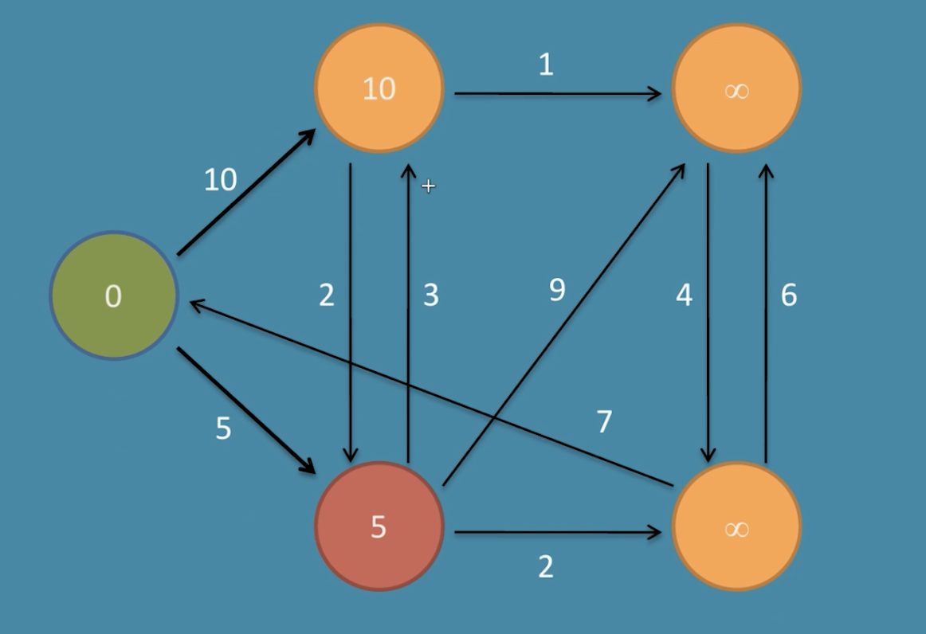
MapReduce. Dijkstra's algorithm. Example

Slide 23
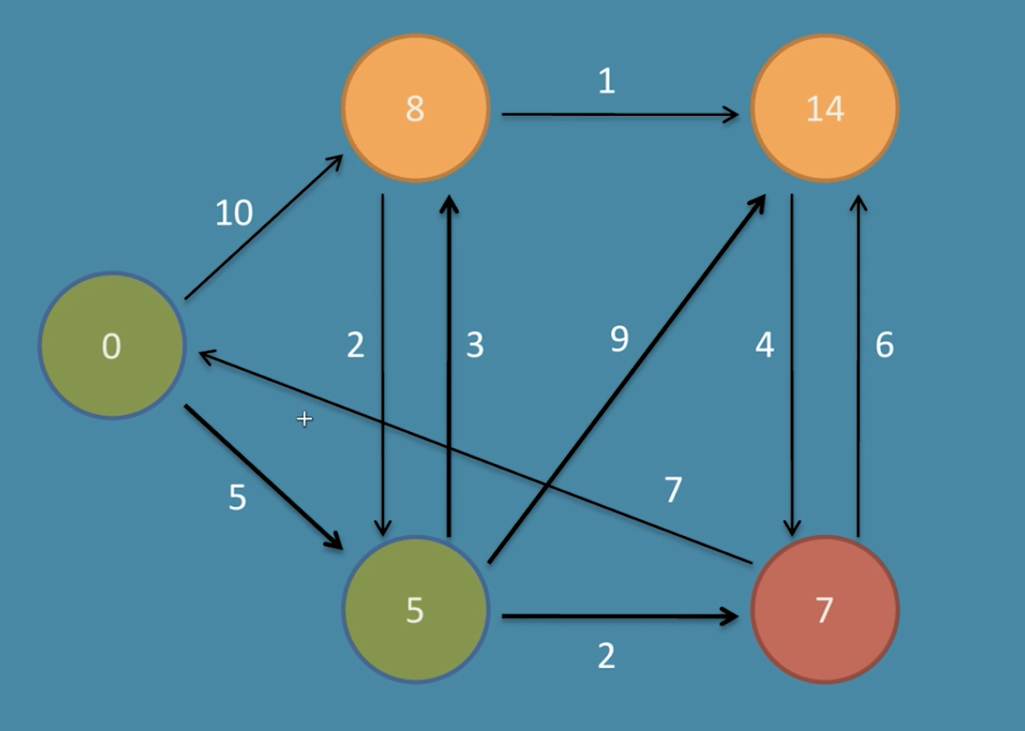
MapReduce. Dijkstra's algorithm. Example

Slide 24
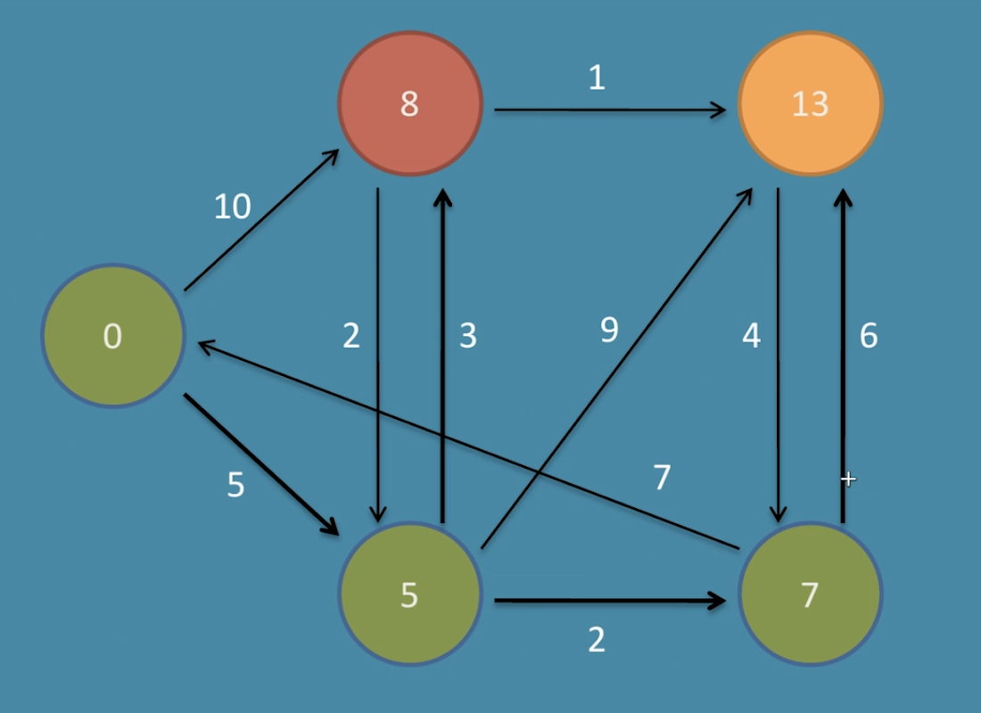
MapReduce. Dijkstra's algorithm. Example

Slide 25
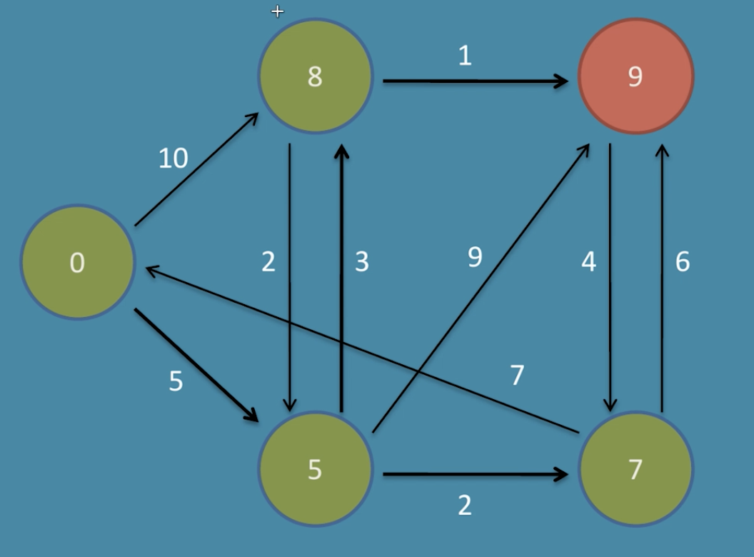
MapReduce. Dijkstra's algorithm. Example

Slide 26
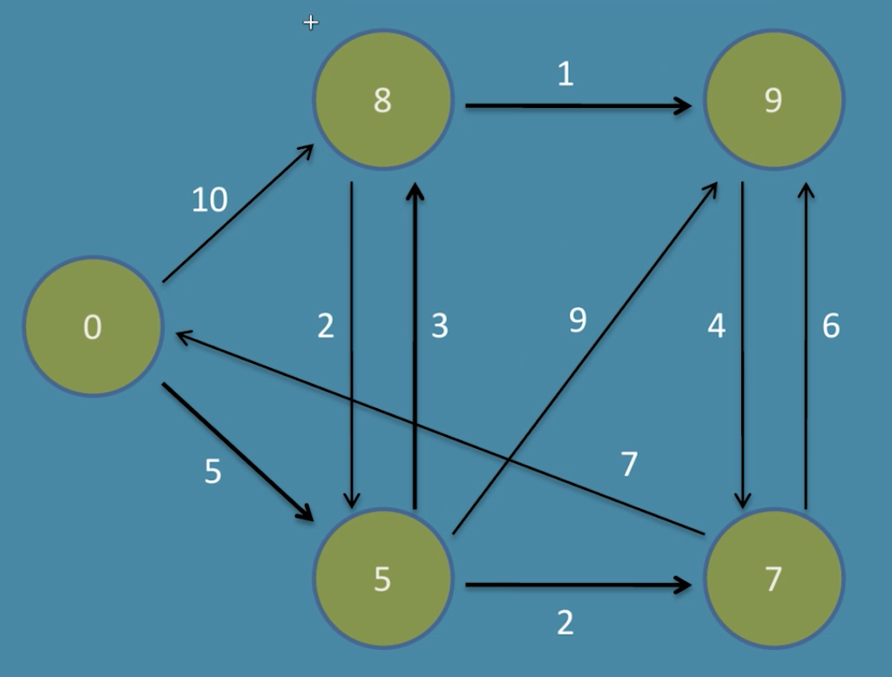
MapReduce. Dijkstra's algorithm. Example

Slide 27
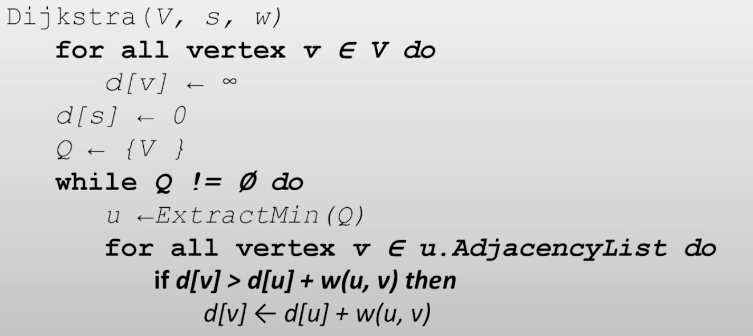
MapReduce. Dijkstra's algorithm
Requires the global priority queue
Hard to parallelize

Slide 28
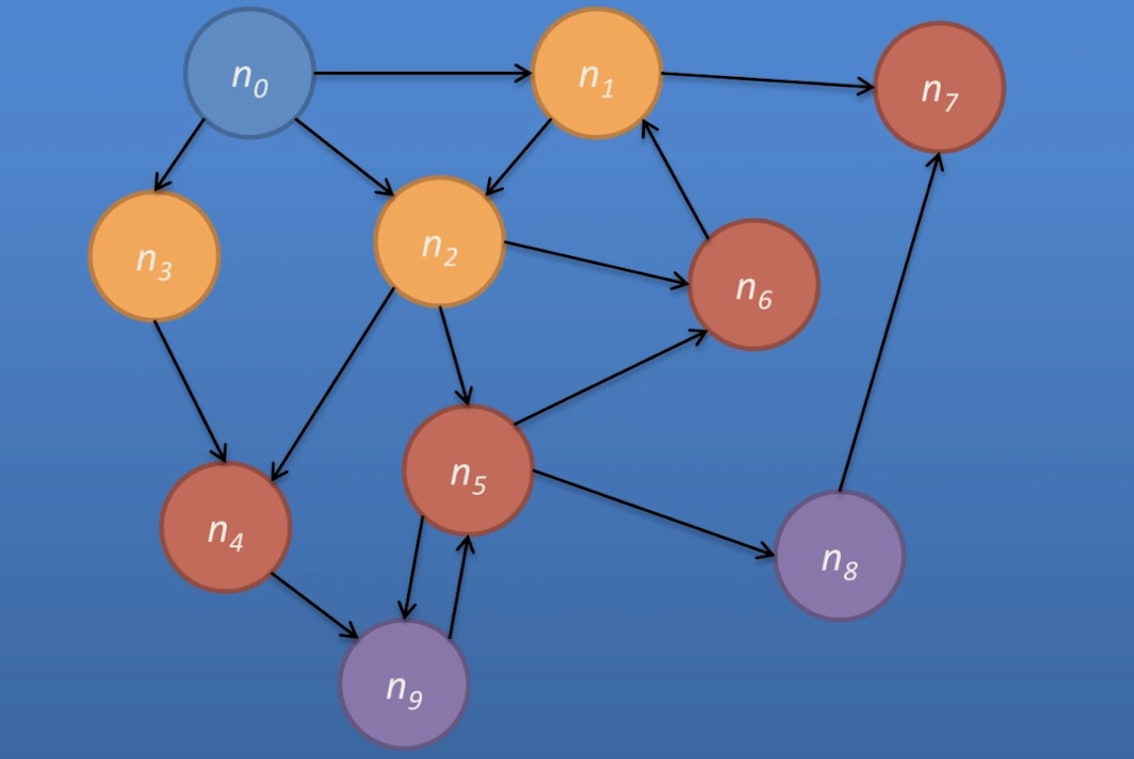
MapReduce. Distributed BFS
Assume all weights are equal to one
BFS will find the shortest path when we first hit the target node
Each iteration of BFS propagates the frontier of nodes with known shortest paths

Slide 29
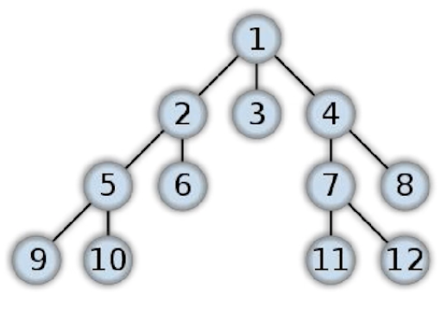
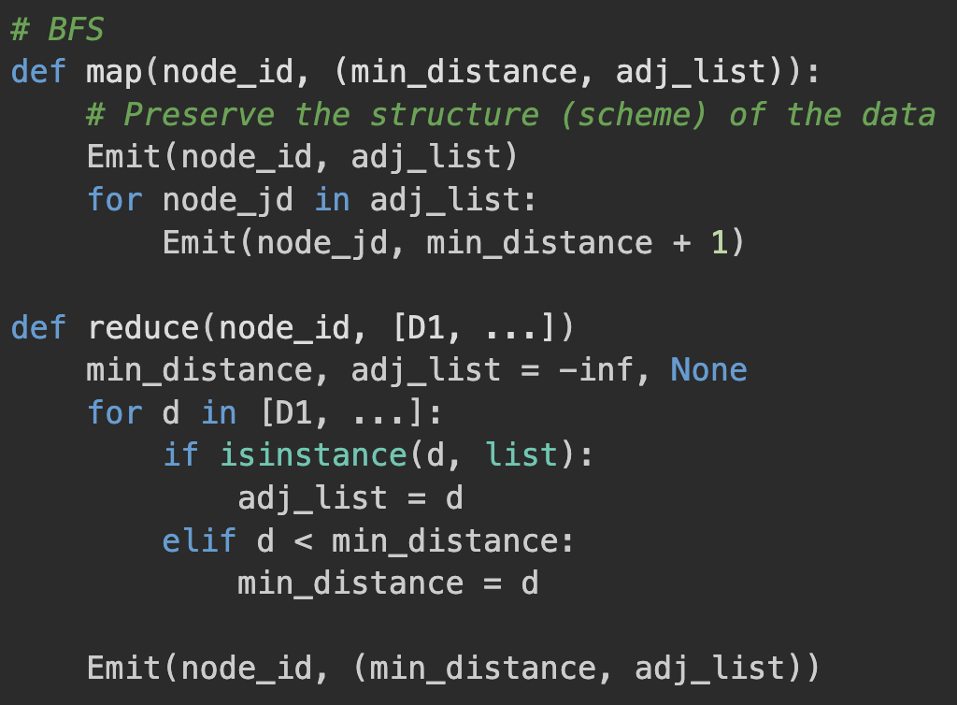
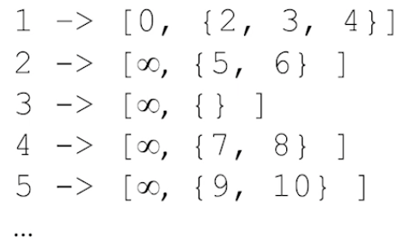
MapReduce. Distributed BFS

Slide 30
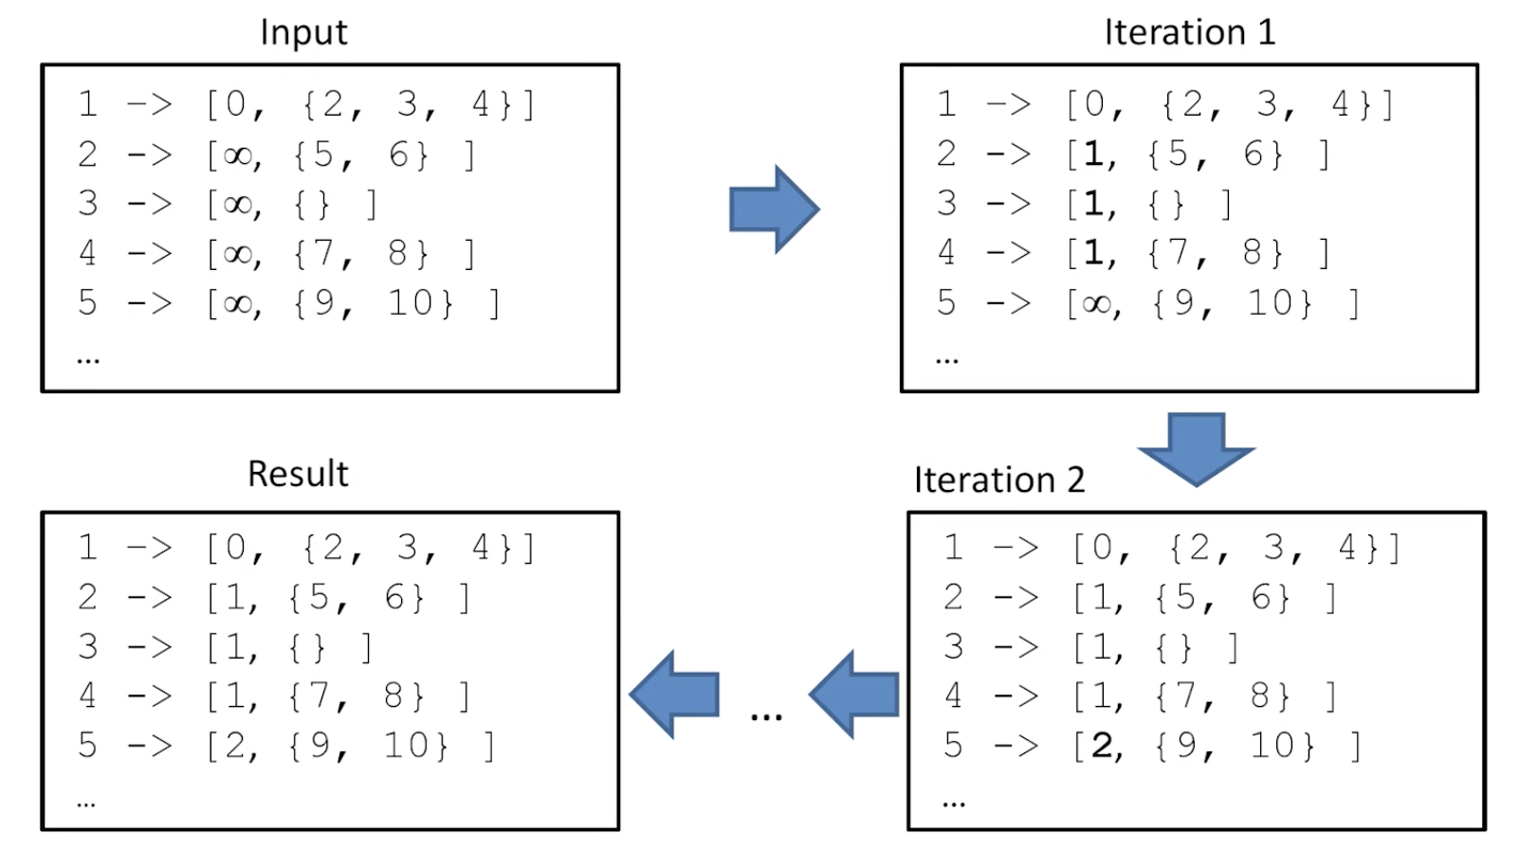
MapReduce. Distributed BFS

Slide 31
MapReduce. Distributed BFS
How to define a stopping criterion?
The first visit to the target node
The number of iterations == graph diameter
Can use:
External driver to check if the criterion is met
Use Hadoop MapReduce Counters
Less effective than Dijkstra's algorithm
Need to preserve the scheme of the graph
Useful for large graphs

Slide 32
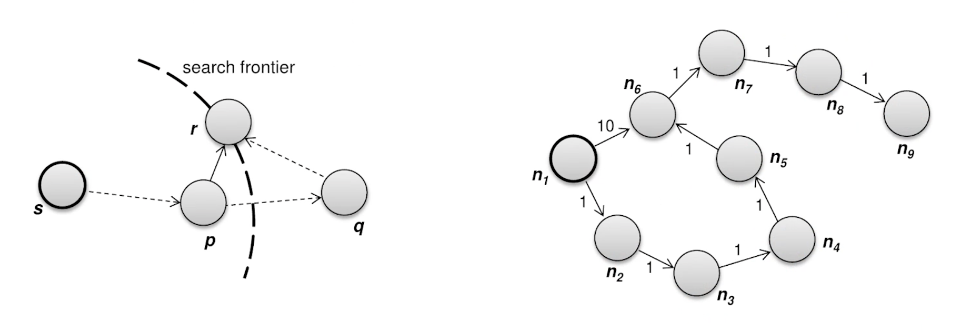
MapReduce. Distributed BFS. Weighted Edges
Emit (min_distance + edge_distance) instead of (min_distance + 1) in Mapper
Need to change the stopping criterion:
|V| - 1 iterations in the worst case
In practice ~ graph diameter
When all distances stay the same
Can use:
External driver to check if the criterion is met
Use Hadoop MapReduce Counters
Equivalent to the Bellman–Ford algorithm

Slide 33
MapReduce. PageRank
Uses the connectivity between sites to define page authority
More inbound links —> more authority
If an inbound link is from a page with high authority —> more authority
Defined as the average time a user will spend on the page when following a random walk:
User starts at a random page
User follows a random link

Slide 34
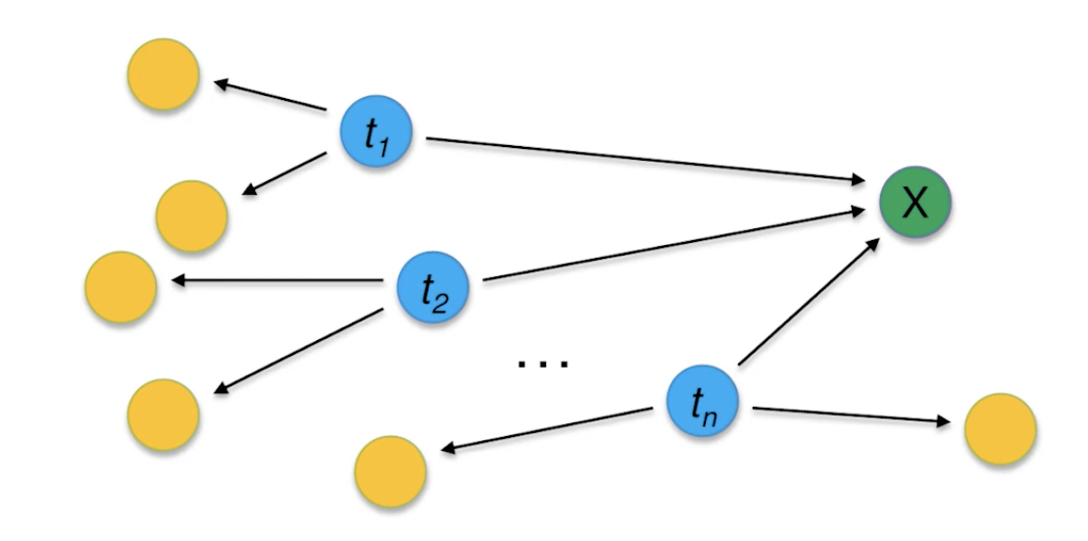
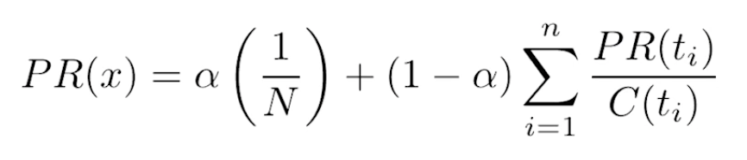
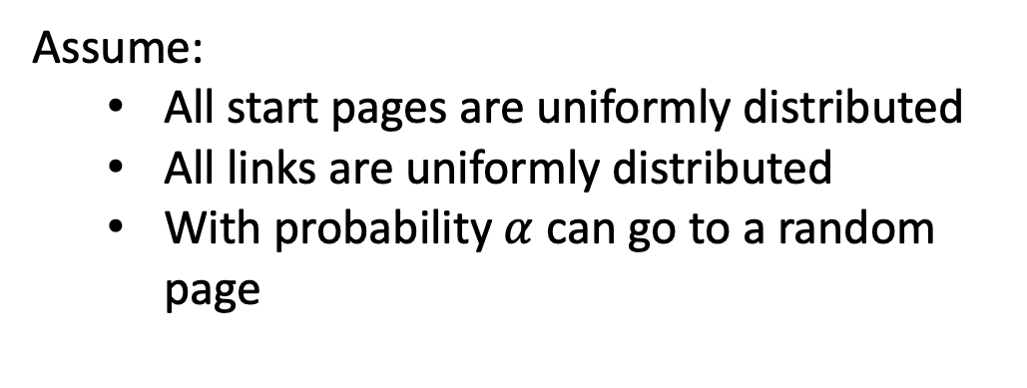
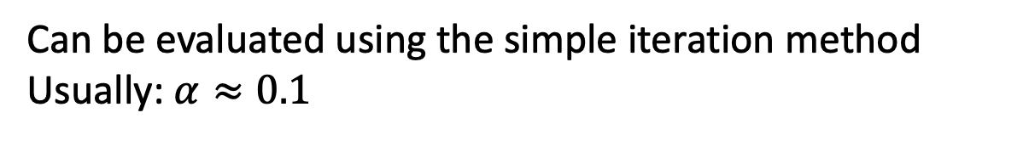
MapReduce. PageRank. Definition
Assume:
All start pages are uniformly distributed
All links are uniformly distributed
With probability $α$ can go to a random page
Then PageRank is defined as a stationary point of the equation:
Can be evaluated using the simple iteration method
Usually: $α≈0.1$

Slide 35
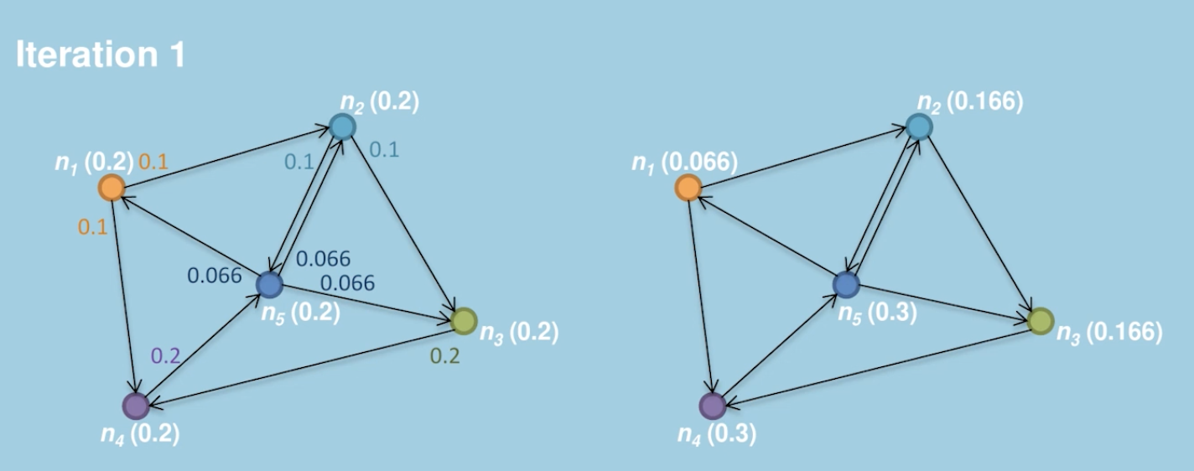
MapReduce. PageRank. Example

Slide 36
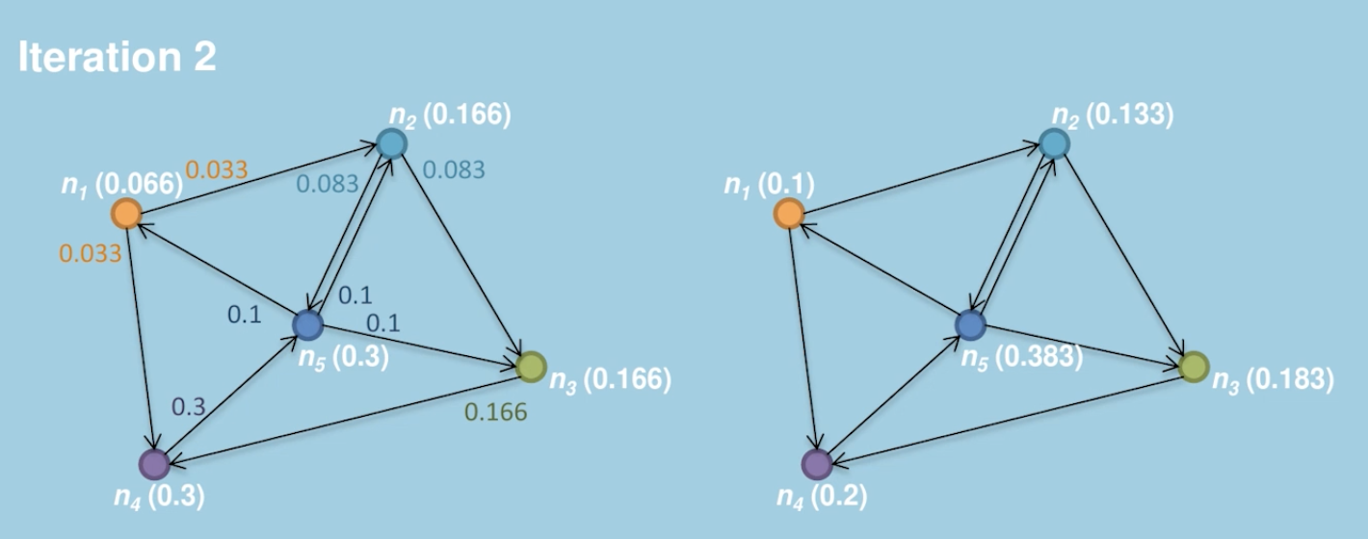
MapReduce. PageRank. Example

Slide 37
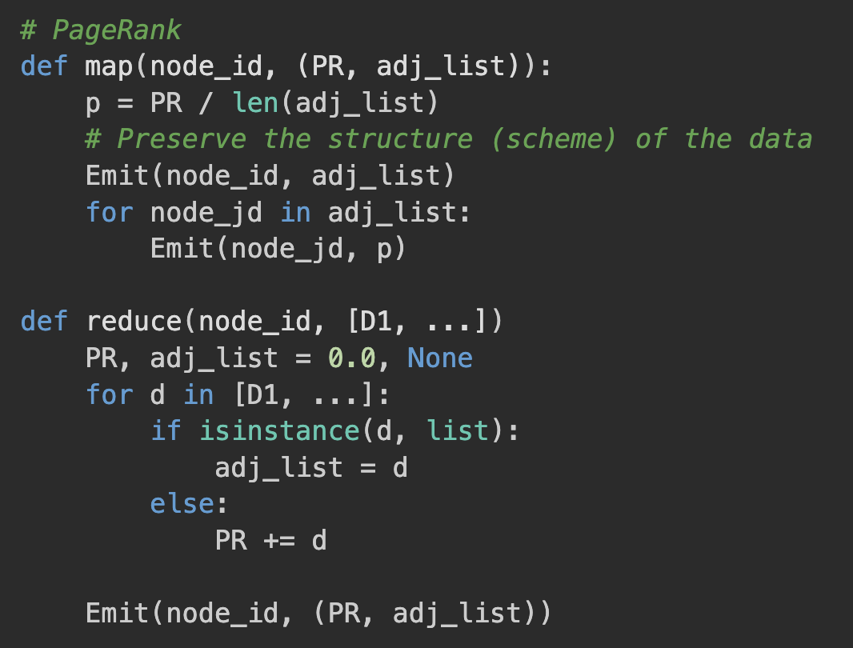
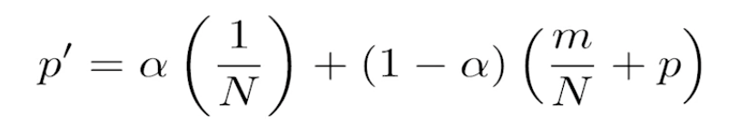
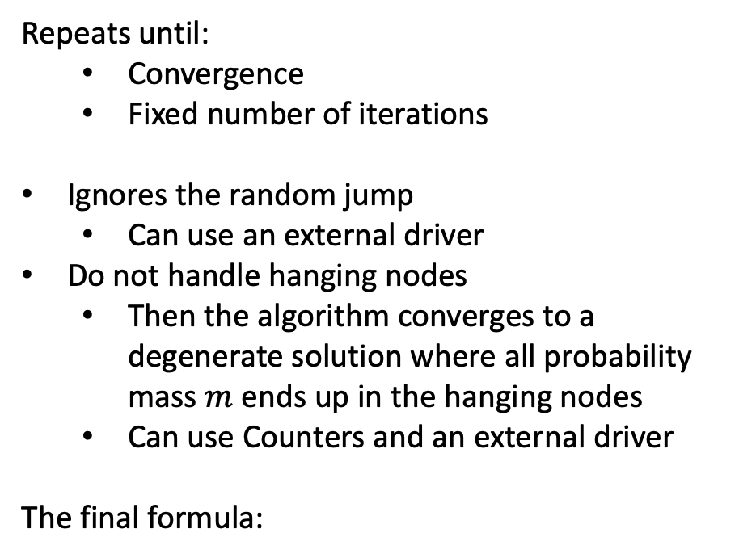
MapReduce. PageRank. Implementation
Repeats until:
Convergence
Fixed number of iterations
Ignores the random jump
Can use an external driver
Do not handle hanging nodes
Then the algorithm converges to a degenerate solution where all probability mass $m$ ends up in the hanging nodes
Can use Counters and an external driver
The final formula:

Slide 38
MapReduce. Graph processing problems
Iterative MapReduce algorithms are inefficient:
Hadoop task startup time
Slow or stuck tasks
The uselessness of the shuffle phase for graphs:
Need to pass the graph structure from the mapper to the reducer
Use In-mapper Combiners
Use the structure broadcasting
Checks at every iteration
Graphs have a strongly connected local structure:
Better to reduce data in correspondence to locality —> custom partitioning

Slide 39
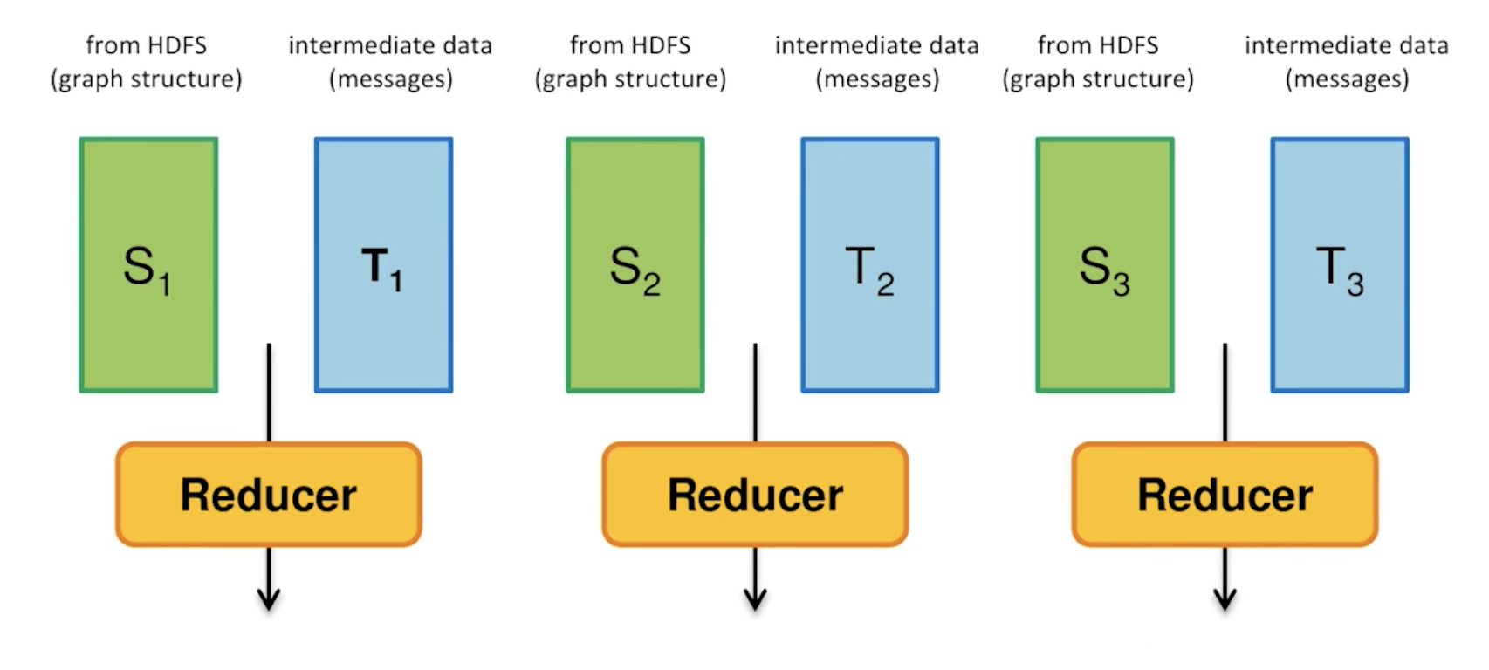
MapReduce. Schimmy Design Pattern
Each reducer reads and outputs the graph structure
Intermediate data and graph structure are consistently partitioned by the key

Slide 40

MapReduce. PageRank Performance

